Slide 1
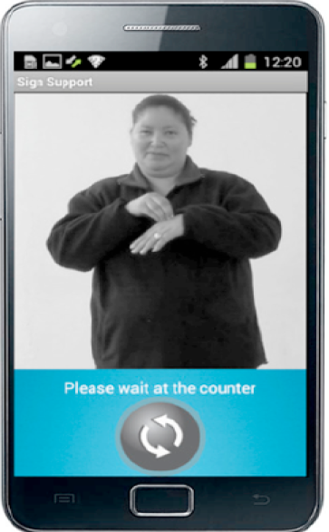
Video notification for SignSupport
Remind Deaf users when and how to take medication
Student : Vuyisa Phindiso
Supervisor : Prof. Bill Tucker

Slide 2
Overview
SignSupport overview
User requirements
Requirements Analysis
Tools to be used
Project plan

Slide 3
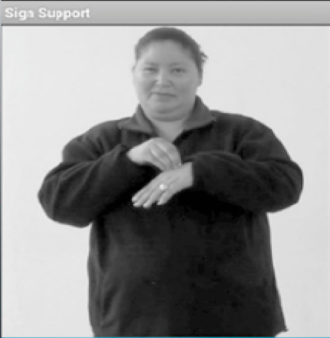
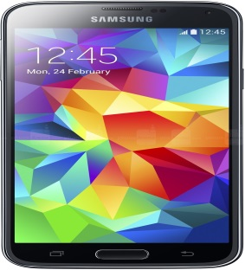
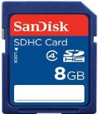
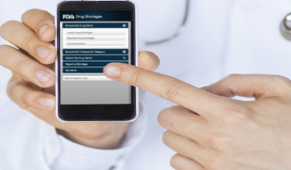
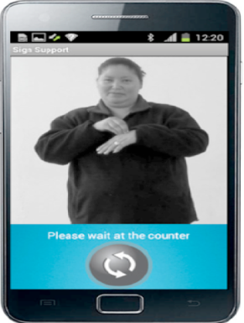
Overview of SignSupport Mobile App
SASL video [3]
Input medication instructions [5]
Medication Instructions in SASL [3]

Slide 4
User Requirements
Intensely vibrating phone [5]
Medication image [3]
SASL video [3]

Slide 5
Requirements Analysis
Phone vibrates and Retrieve SASL video
Medication image
SASL video plays
Tap to play video

Slide 6
Tools to be used
Eclipse IDE [2]
Java programming language [4]
Android platform [5]
Samsung galaxy phone

Slide 7
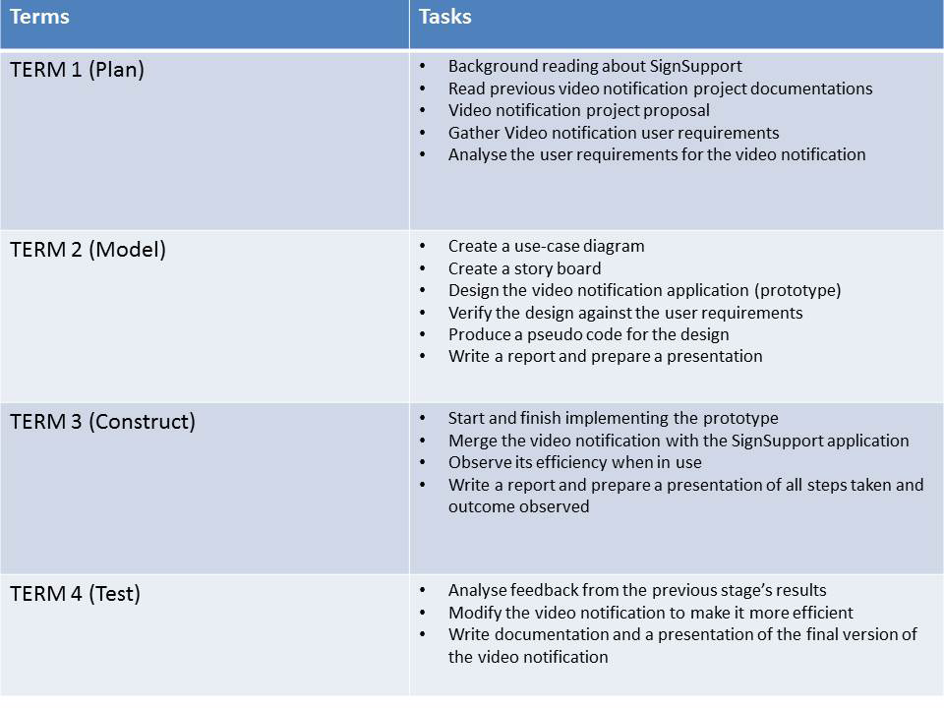
Project plan

Slide 8
References
[1] Prangnat Chininthorn (September 2011). "Communication Tool Design
for Deaf to Hearing in South Africa “
[2] Eclipse IDE https://blog.idrsolutions.com/2013/07/eclipse/
[3] Michael B. Motlhabi, William D. Tucker, Mariam B. Parker, "Improving Usability and Correctness of a Mobile Tool to help a Deaf person with Pharmaceutical Instruction“
[4] Java programming language http://www.digitaltrends.com/computing
[5 ] Android platform http://hypercubenews.blogspot.com

Slide 9
Thank you

